Slide 1

FLIGHT DELAY ANALYSIS
FLIGHT DELAY ANALYSIS

Slide 2
FLIGHT DELAY ANALYSIS
Predicting the airport with minimum flight delay among all the airports within a city

Slide 3
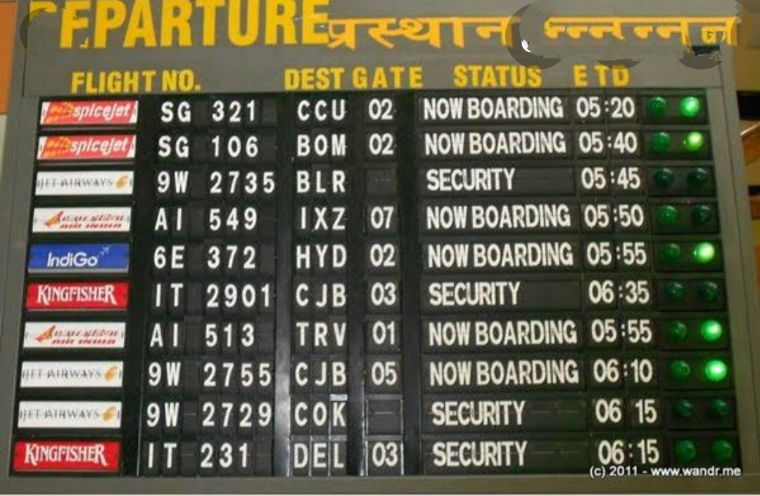

INTRODUCTION:
For this analysis, we analyzed data that came from the US department of Transportation for commerical flight data.
In a particular city there can be multiple airports.
If a traveller plans a visit to his/her destination then his target will be to avoid the delay at the airport which might occur because of multiple reasons like weather, traffic, maintenance delay, etc.
Our solution helps traveller by providing him the airport choice that will have minimum delay for flights.

Slide 4
GOAL AND OBJECTIVE
Develop a business model to predict flight delays.
Optimize flight operations.
Reduce further economic loss for airlines.
Less inconvenience occurred to passengers.

Slide 5
PROBLEM STATEMENT:
A traveller has to fly to a particular destination on a particular day.
There are mutiple airports within a city and multiple flights to the destination.
Traveller want to pick up airport where flights is minimum delayed.

Slide 6
OUR APPROACH:
Exploratory Data Analysis
Data Extraction and Data preprocessing
Training ML models :
Decision tree classifier
Logistic regression
Performance
Testing Models

Slide 7
ABOUT THE DATA
The data is taken from kaggle which is publicly available dataset on flight arrivals and departure.
Data available from 1987 to 2008 but we will use most recent data due to variable availability.
We will ignore data of years 1988,1999,2000... in order to avoid EI Nino which might create bias in the model.
Doing all this to ensure variable consistency across entire dataset.
We are finally using the dataset of 2008.
Dataset contains 60 rows and 15 columns.

Slide 8
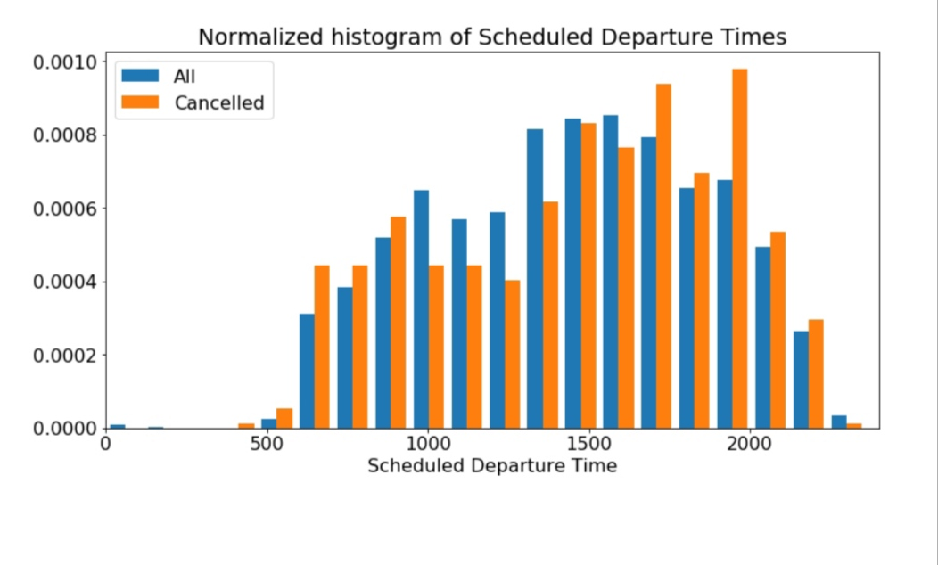
DATA VISUALIZATION

Slide 9
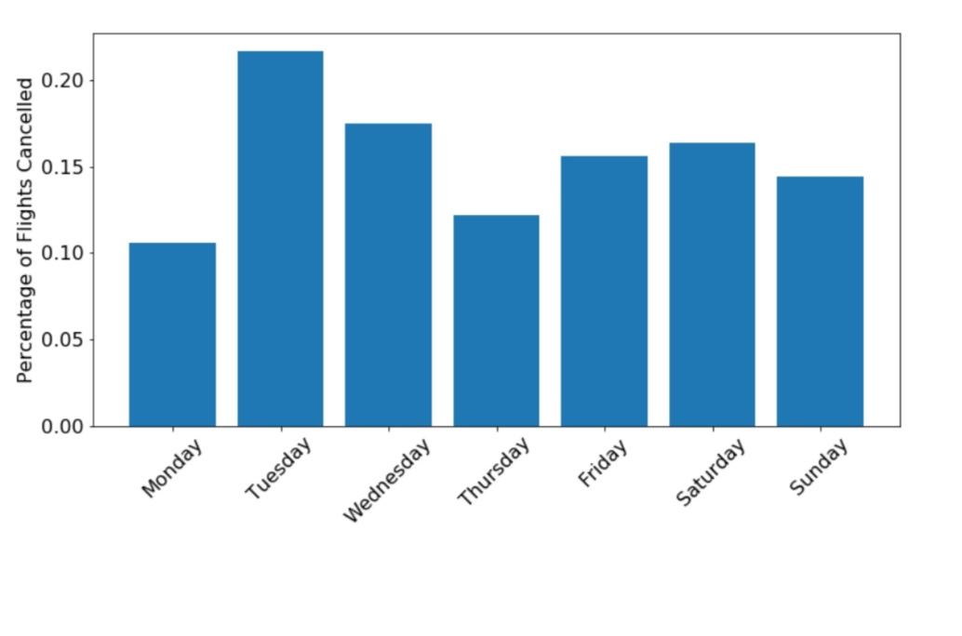

Slide 10
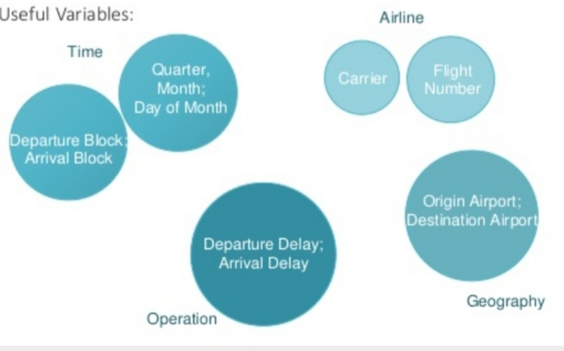
DATA UNDERSTANDING

Slide 11
ASSUMPTIONS
We make a number of a assumptions in our analysis that are to be noted.
The model is for business users who are sure of the date of travel and the destination but not particular about the time of the departure. The main motto is that they depart from the city on the same day with the least delay possible.
The model assumes that the flight is non-stop. We will not deal with any kind of connection flights in the data.
The model assumes that the user is indifferent to the price difference between the given number of the airports.

Slide 12
Dataset- parameters
Parameters | Description
Year | Year
Month | Month
Day of month | Day of month
Dep time | Departure time
DepCRStime | Scheduled departure time
Arr time | Arrival time
ArrCRStime | Scheduled Arrival Time
Unique Carrier | Airline carrier code
Flight number | Number of flight
Tail number | Unique aircraft registration num
Origin | Origin Airport code
Dest | Destination Airport code
Distance | Distance between dest & origin
Flight delay | Lenght of delay in minutes

Slide 13
Data preprocessing
Data preprocessing has 7 steps.
1.Import the libraries.
2.Importing the dataset.
3.Data Visualization.
4.Taking care of missing data.
5.Label Encoding.
6.One Hot Encoding.
7.Feature Scaling.
8.splitting data into Train and Test.

Slide 14
Data preprocessing
Challenges and solutions:
Large dataset is taken into small.
Columns with categorical values:
All categorical variables including Origin, Destination, and Tailnumber converted into numerical values to make them ready for modelling.
Missing values were handled. Removed missing values which were denoted by NAN.
Removed all the cancelled flights.
Processing done so that all data is in proper format to perform calculation.
We structured the data using python library called 'pandas'.
All string data was converted to integer format to perform model calculations.

Slide 15
DECISION TREE CLASSIFICATION ALGORITHM

Slide 16
DECISION TREE CLASSIFICATION ALGORITHM
Decision Tree: As the name suggest the main idea behind decision tree algorithm is to make a tree like structure and get the answers in form of true of false. The model begins from a root node and ends on the decision. Each node receives a Yes No question and answer is passed on to the next node. Root node gets all the input of the training dataset.
The challenge to assembling such a tree is that question to ask at a node and when. To do this, decision tree algorithmic program uses accepted indices like entropy or Gini-impurity to quantify an uncertainty or impurity related to an explicit node. Equations (1) and (2) show however entropy and Gini impurity are calculated, severally, for a setoff information. Within the equations, C is that the variety of classes[1].

Slide 17
LOGISTIC REGRESSION

Slide 18
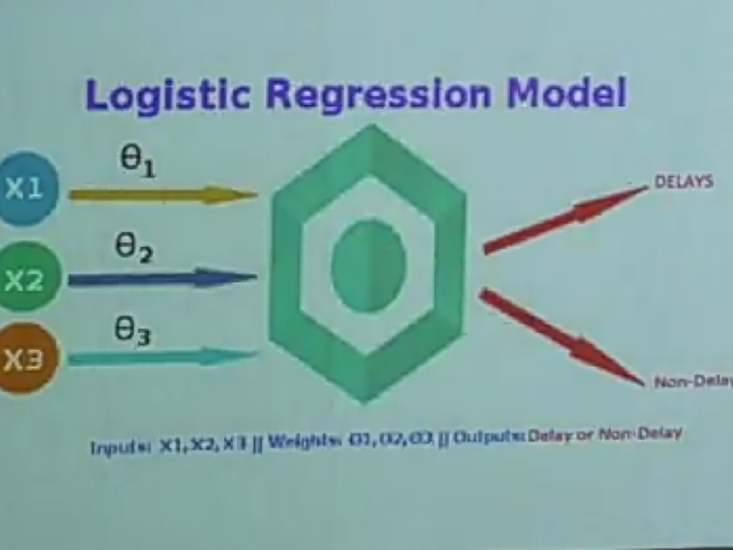

Slide 19
Why logistic regression
Its parameter estimates are fully efficient.
It is suitable for prediction with relatively few variables.
Its results are easy to interpret and draw conclusions about the relative impact of model inputs based on their coefficients.
Exploratory data analysis hinted at a possibility of linear relationship between the variables in our dataset and the binary outcome of a delay/ no delay.

Slide 20
GRADIENT DESCENT
Our logistic regression is modeled as (no inbuilt library was used)
P(delay) = B0+B1X1+B2X2+....... +BmX
This model uses a gradient descent algorithm to estimate coefficients for each variable.
The learning model is designed to iterate over the training data and converge to a global solution.
Once the coefficients values are determined, the model is then tested again a different sample of the data.

Slide 21
Model Training and Testing
method = 'all' : all input data is used to train and then test the model
method = 'split' : we use the train_test_split() method of sklearn to define test & training sets
Then, the other methods of the class have the following functions:
train (n) : drives the data on the training set and makes a polynomial of order n
predict (X) : calculates the Y points associated with the X input and for the previously driven model
calc_score () : calculates the model score in relation to the test set data

Slide 22
Training model
Train (n, nb_folds) : defined 'nb_folds' training sets from the initial dataset and drives a 'n' order polynomial on each of these sets. This method returns as a result the Y predictions obtained for the different test sets.
By default, the 'K-fold' method is used by sklearn cross_val_predict () and cross_val_score () methods. These methods are deterministic in the choice of the K folds, which implies that for a fixed K value, the results obtained using these methods will always being used.
Testing
At this stage, the model was driven is tested on the training set which include the data of the first 3 weeks of January. We now look at the comparison of predictions and observations for the fourth week of January:

Slide 23
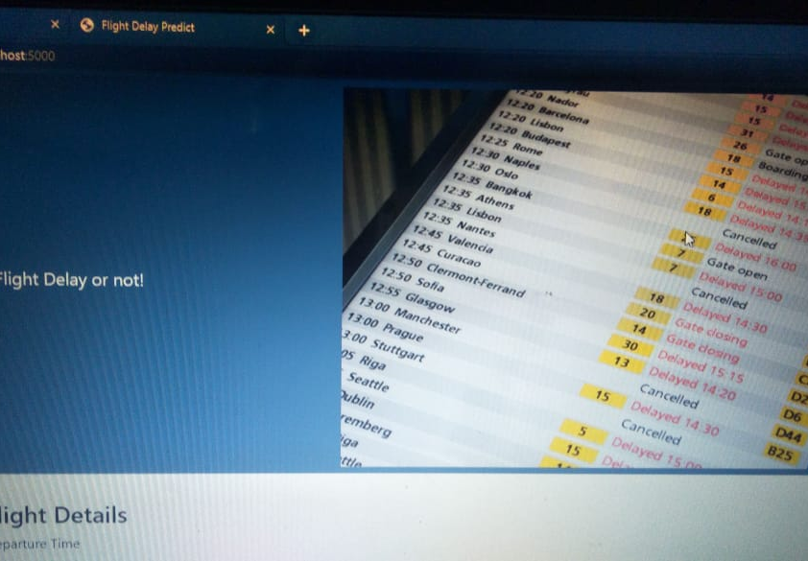
OUTPUT

Slide 24
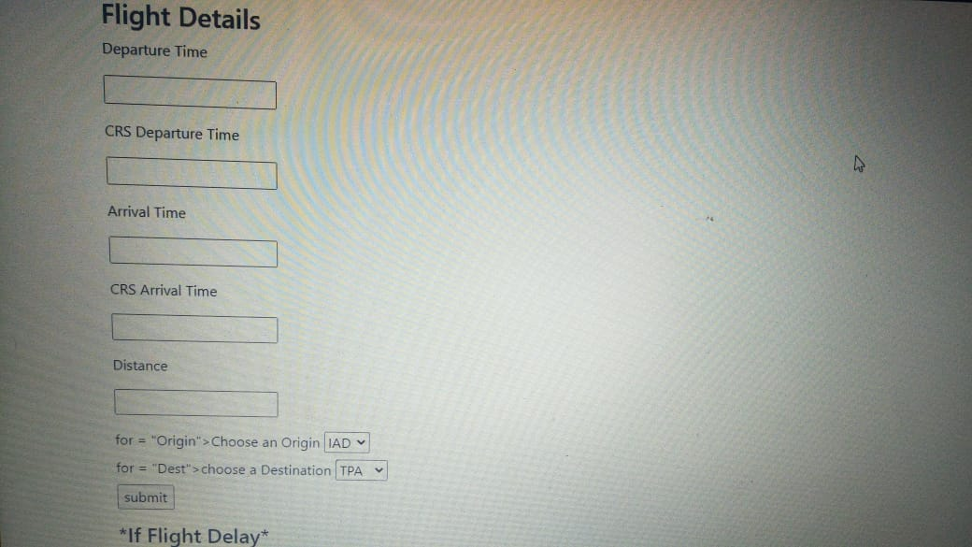

Slide 25
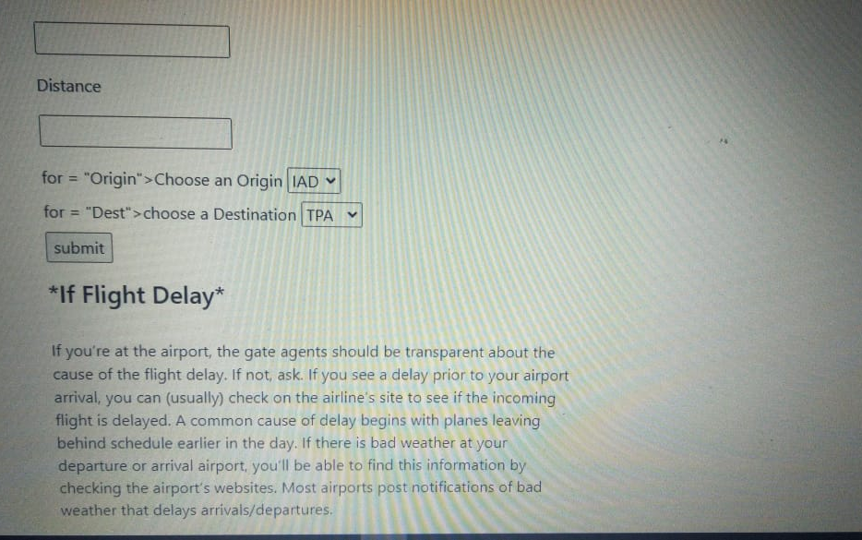

Slide 26
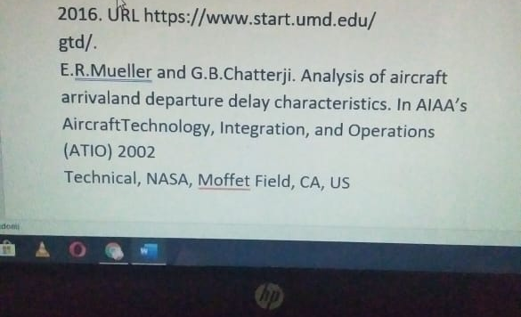

Slide 28
FUTURE SCOPE
Further supportive study is required to correlate all the problem, scope and method for getting most accurate result. Although weather conditions are the major reasons for flight delay, other unprecedented events such as major calamities , natural or man-made can cause major delay in flight.

Slide 29


